Slide 1












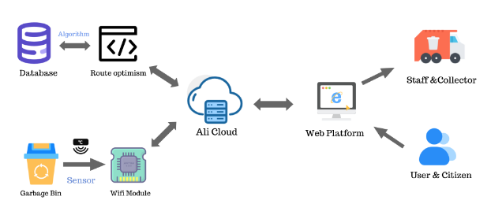
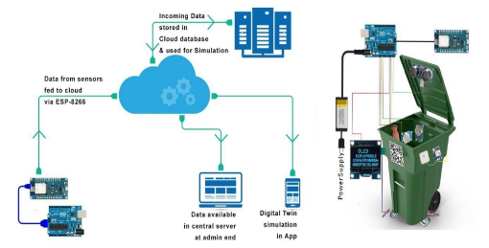

Notes:
Hi, everyone one. I am Hanlin CAI, the first-author of the Paper (An IoT Garbage Monitoring System for Effective Garbage Management). So now, let's start my presentation.

Slide 2







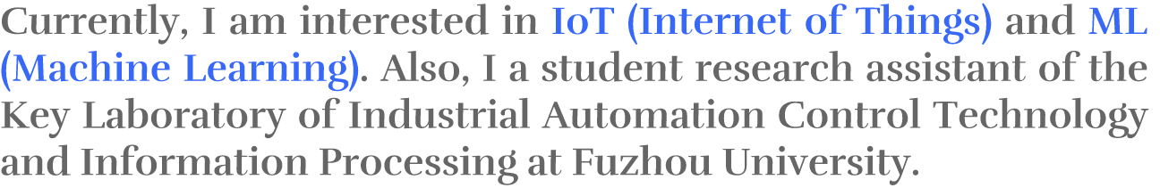



Notes:
So the first part is the self-introduction. My name is Hanlin CAI, a junior student majoring in Automation at Fuzhou University, China, and Robotics at Maynooth University, Ireland, which is a China-Ireland cooperative program. Currently, I am interested in the Internet of Things and Machine Learning. Recently, I have been nominated for 2022 China National Scholarship.

Slide 3




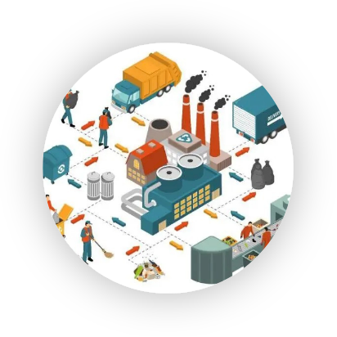
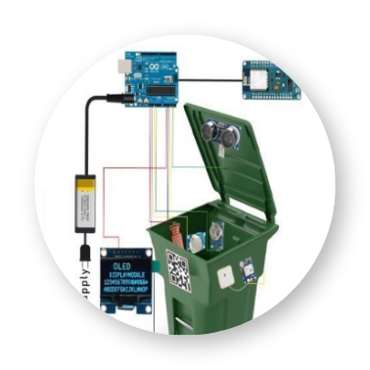
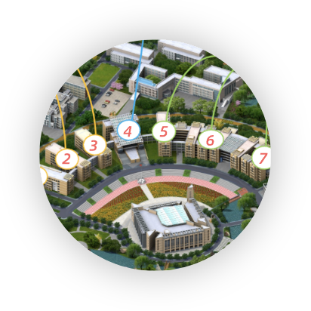







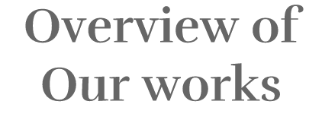



Notes:
And in today’s presentation, I will mainly talk about 4 parts of thing. First, is the research background. Second, is the overview of our works.
Then, is the experiments we executed and the corresponding results. And, finally, I will explain the conclusion and our future plan.

Slide 4






Notes:
So now, let's we move to the first part, background and literature review.

Slide 5



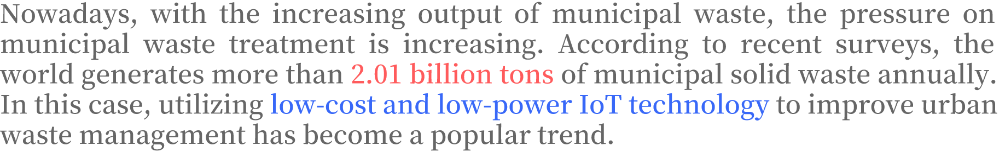
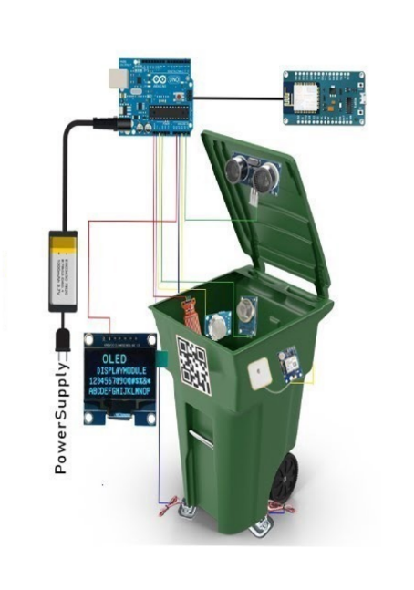
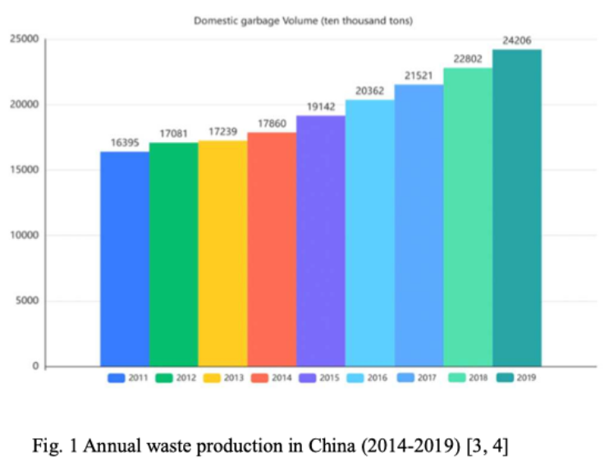
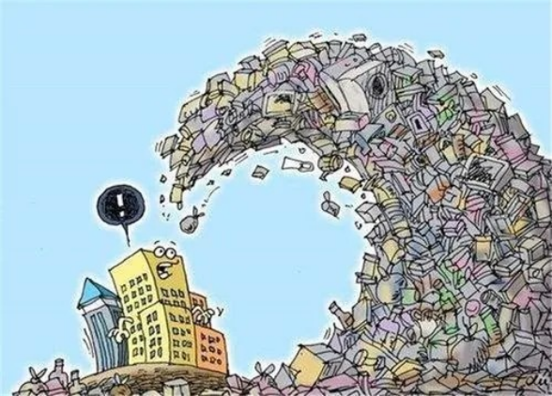
Notes:
Nowadays, with the increasing output of *municipal waste*, the pressure on municipal waste treatment is increasing. According to recent surveys, the world generates more than 2.01 billion tons of municipal solid waste annually. In this case, utilizing low-cost and low-power IoT technology to improve urban waste management has become a popular trend.

Slide 6

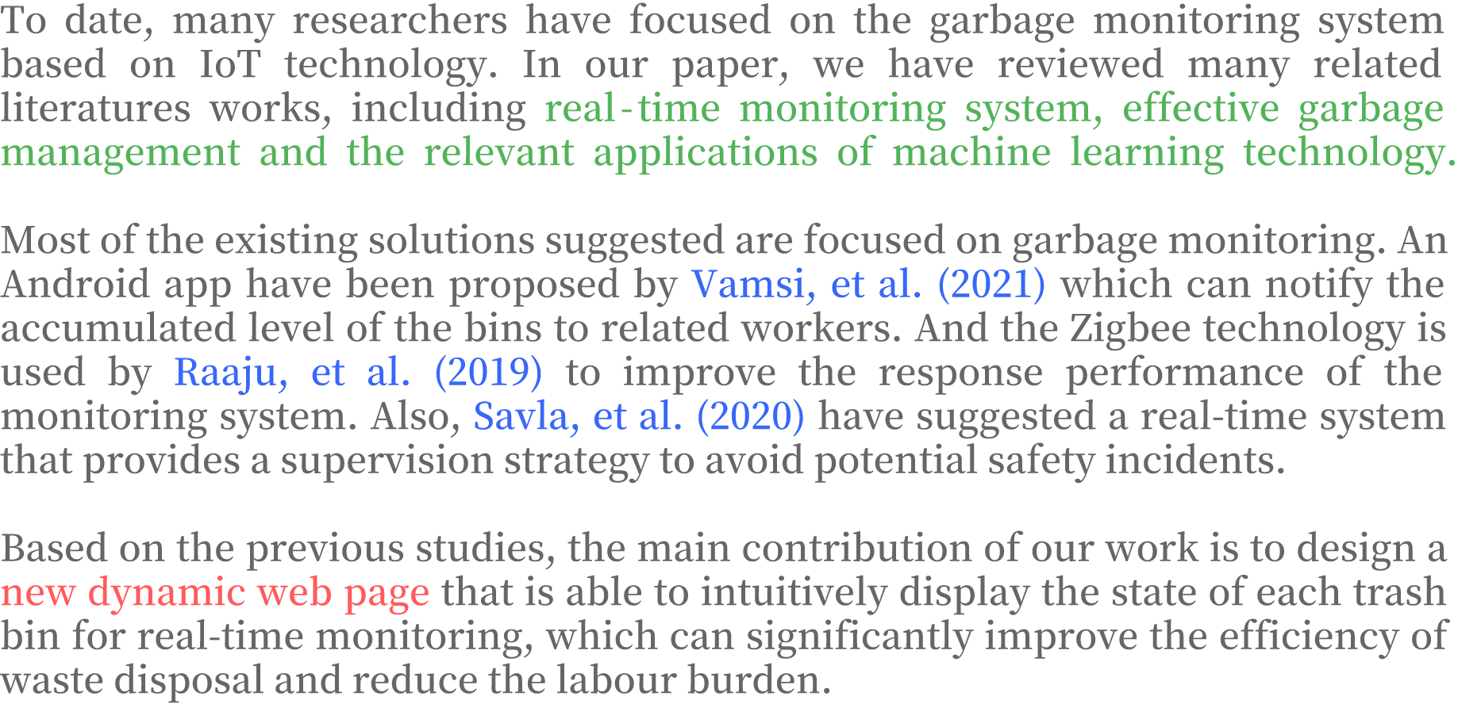
Notes:
To date, many researchers have focused on the garbage monitoring system based on IoT technology. In our paper, we have reviewed many related literatures works, including real-time monitoring system, effective garbage management and the relevant applications of machine learning technology.
The following paragraph presents some recent works.And based on these previous studies, the main contribution of our work is to design a new dynamic web page, that is able to intuitively display the state of each trash bin for real-time monitoring.

Slide 7



Notes:
And then, let's we move to talk about the overview of the proposed works.

Slide 8

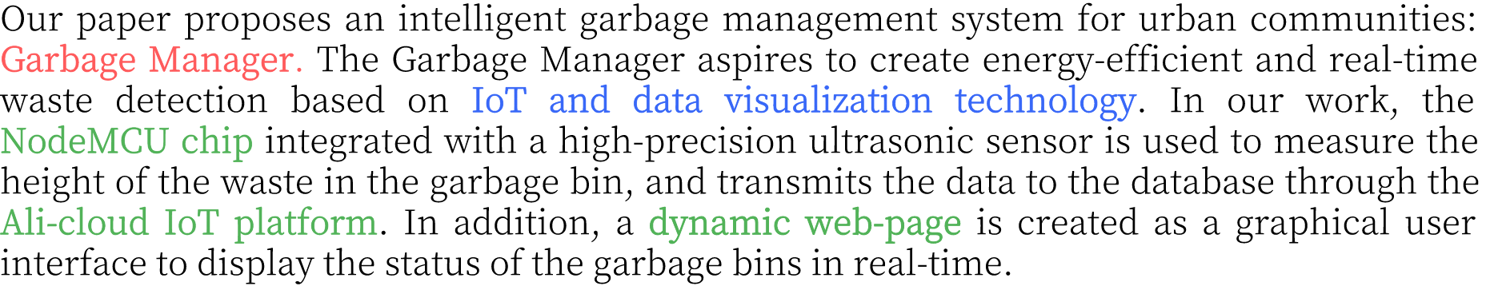
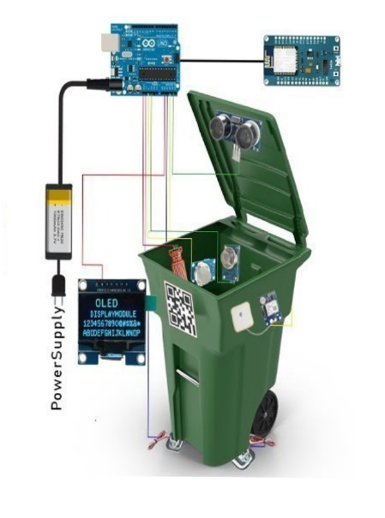
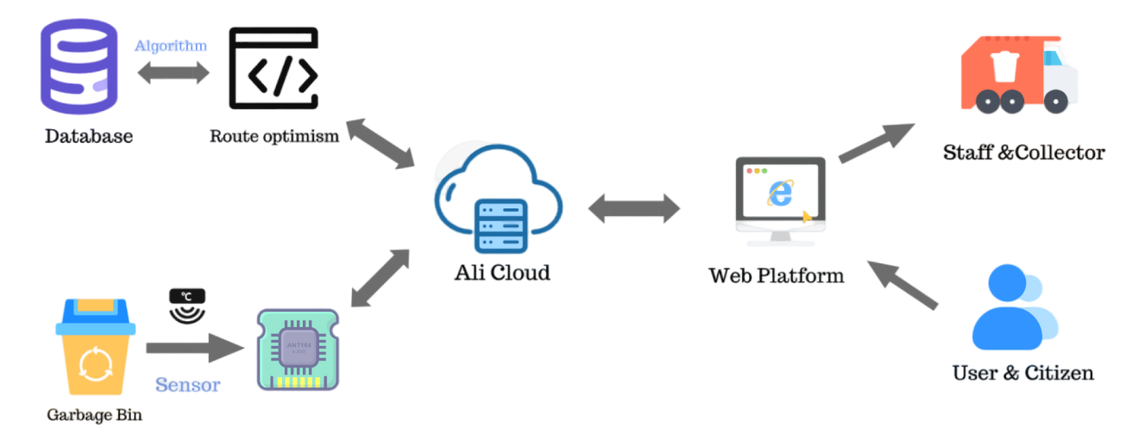
Notes:
So, our paper proposes an intelligent garbage management system for urban communities: **Garbage Manager**. The Garbage Manager aspires to create energy-efficient and real-time waste detection based on IoT and data visualization technology.
In our work, the NodeMCU chip integrated with a high-precision ultrasonic sensor is used to measure the height of the waste in the garbage bin, and transmits the data to the database through the Ali-cloud IoT platform. In addition, a dynamic web-page is created as a graphical user interface to display the status of the garbage bins in real-time.

Slide 9

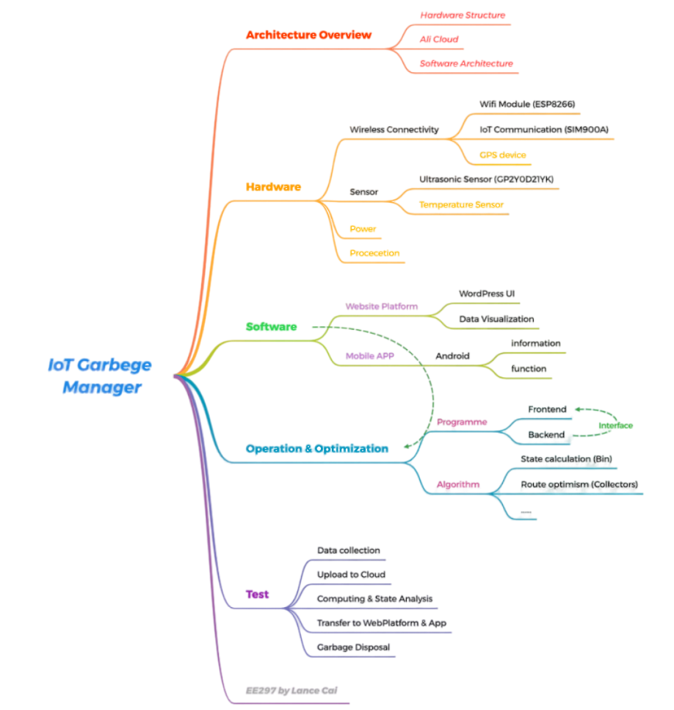
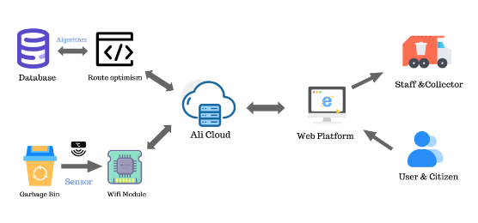
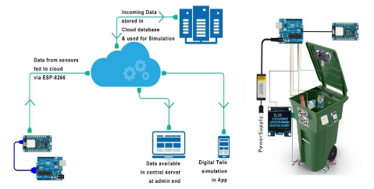
Notes:
As for the specific information, our system possess three kinds of sensors: ultrasonic, temperature and humidity sensors. And, we ultized the ESP-8266 as our wifi module for data transmission. Also, the NodeMCU is used as IoT platform and we choose the Ali-Cloud as the Server of our system.

Slide 10

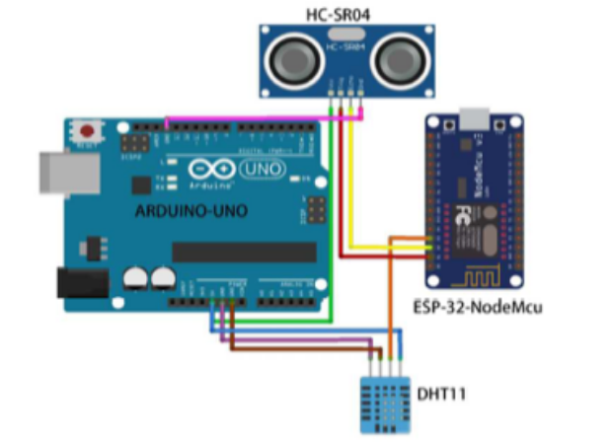
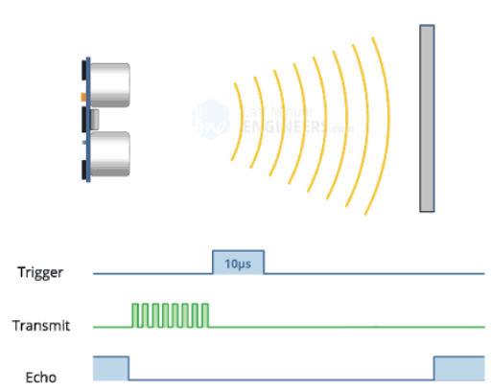
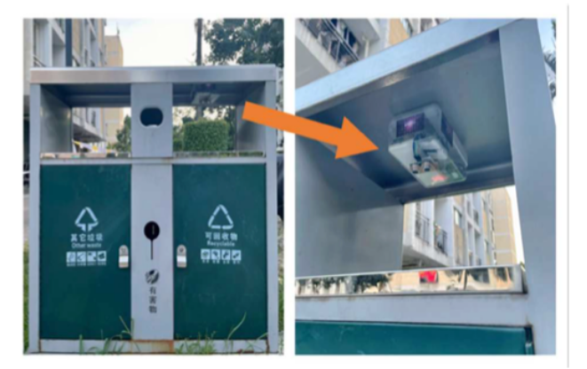
Notes:
Besides, as for the main function of each hardware, as the figures shown, the sensors are used to collect the data in real-time.
And, the wifi module is used for uploading the data to Ali-Cloud server. Arduino Uno is used to connect the hardware and software.

Slide 11
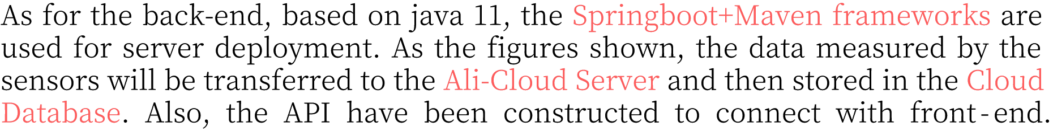
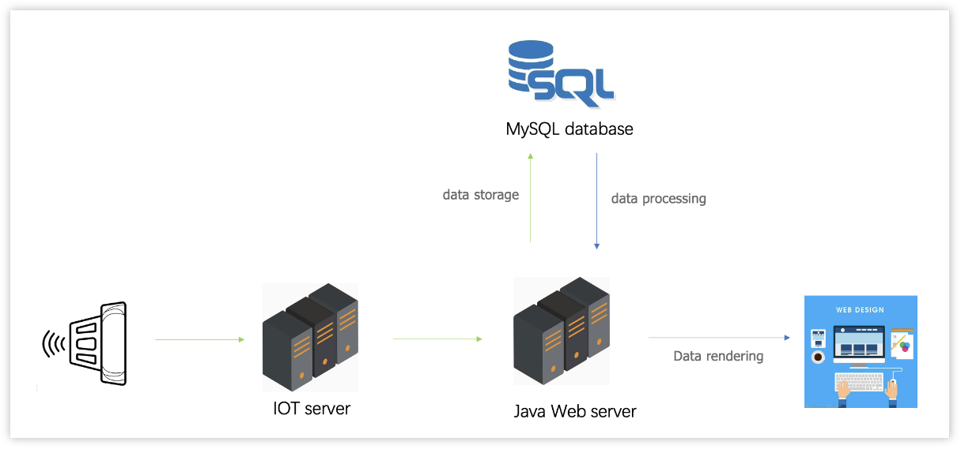
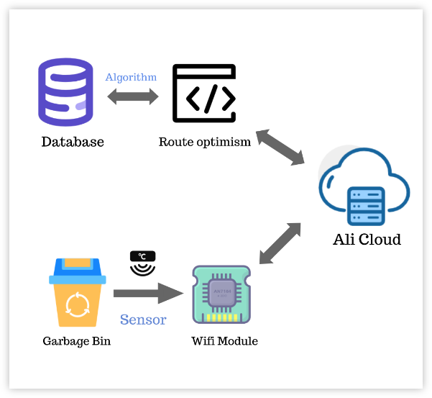
Notes:
Then, is the back-end of our system. Based on Java 11, the *Springboot+Maven frameworks* are utilized for Server deployment. As the figures shown, the data measured by the sensors will be transferred to the Ali-Cloud Server and then stored in the Cloud Database. Also, the API have been constructed to connect with front-end.

Slide 12
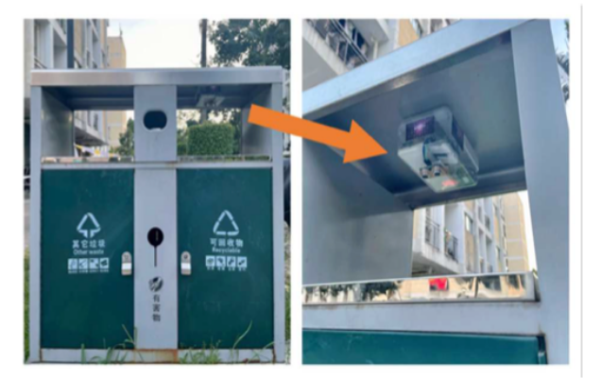
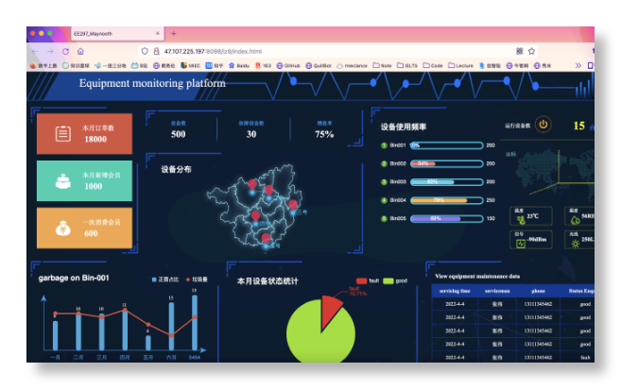
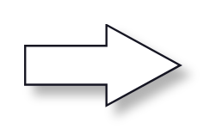
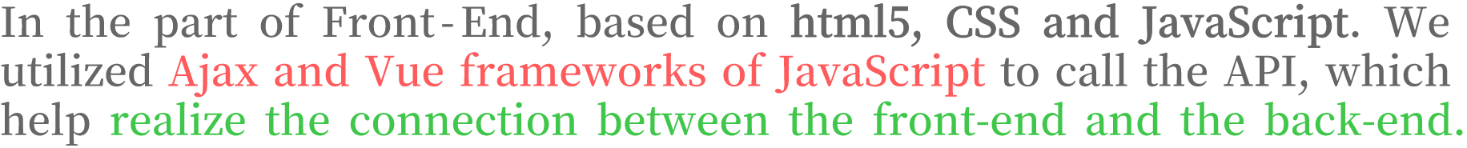
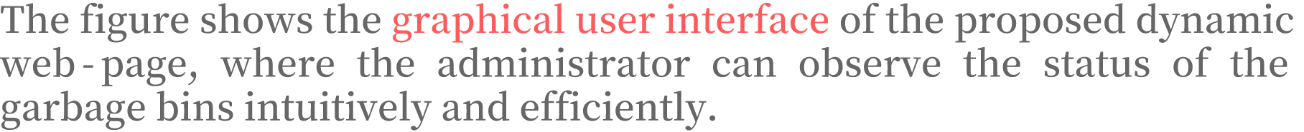
Notes:
After talking about the back-end, the next is the front-end, based on html5, CSS and JavaScript. We utilized Ajax and Vue frameworks of JavaScript to call the API, which help realize the connection between the front-end and the back-end.
The figure shows the graphical user interface of the proposed dynamic web-page, where the administrator can observe the status of the garbage bins intuitively and efficiently.

Slide 13


Notes:
Okay, after introducing our design methodology, now let’s we move to the part of real-world experiments.

Slide 14

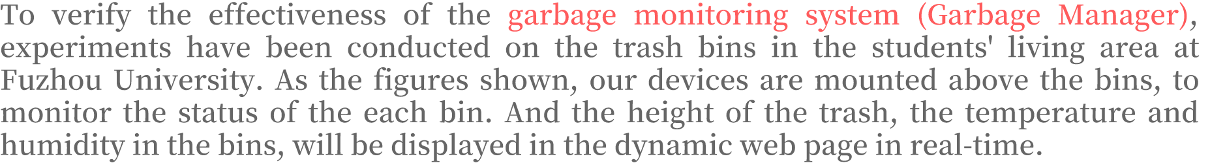
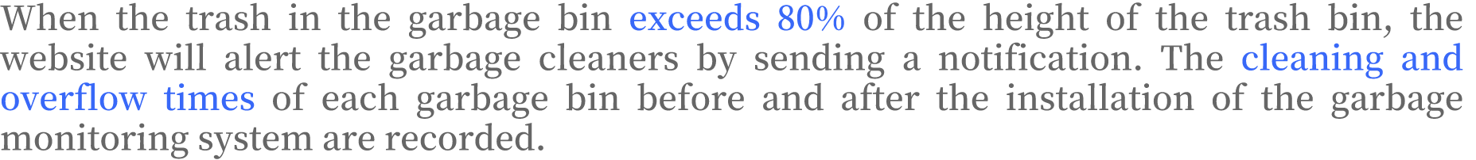
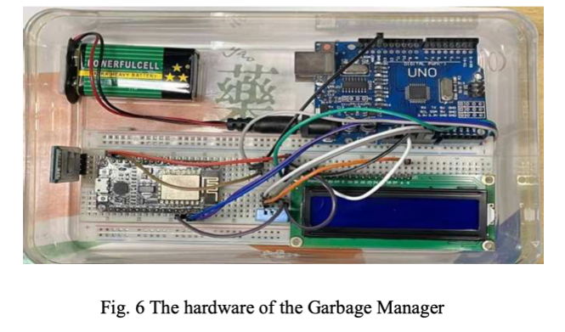
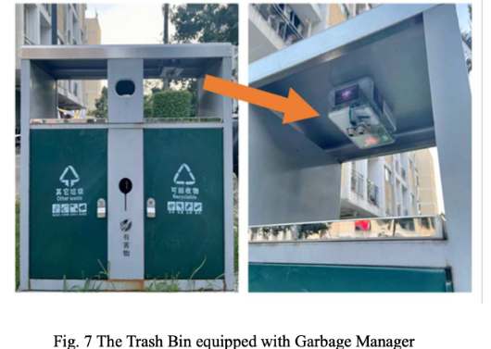
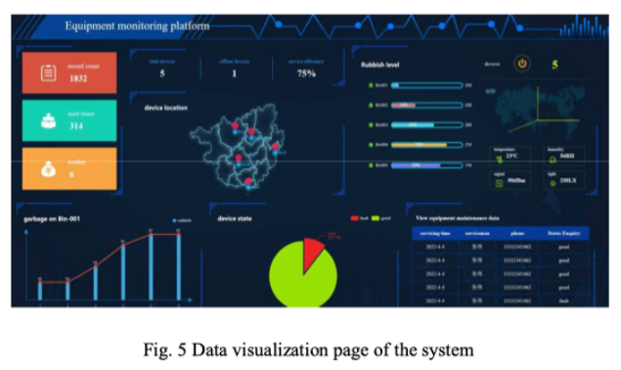
Notes:
To verify the effectiveness of the garbage monitoring system (Garbage Manager), experiments have been conducted on the trash bins in the students' living area at Fuzhou University. As the figures shown, our devices are mounted above the bins, to monitor the status of the each bin. And the height of the trash, the temperature and humidity in the bins, will be displayed in the dynamic web page in real-time.
When the trash in the garbage bin exceeds 80% of the height of the trash bin, the website will alert the garbage cleaners by sending a notification. The cleaning and overflow times of each garbage bin before and after the installation of the garbage monitoring system are recorded.

Slide 15

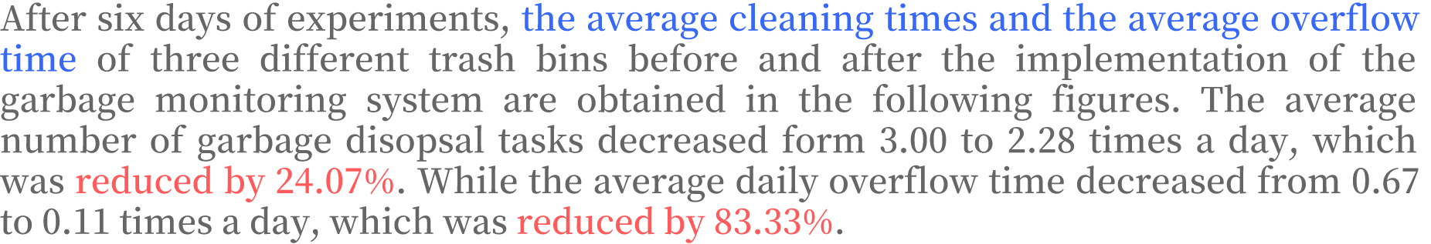
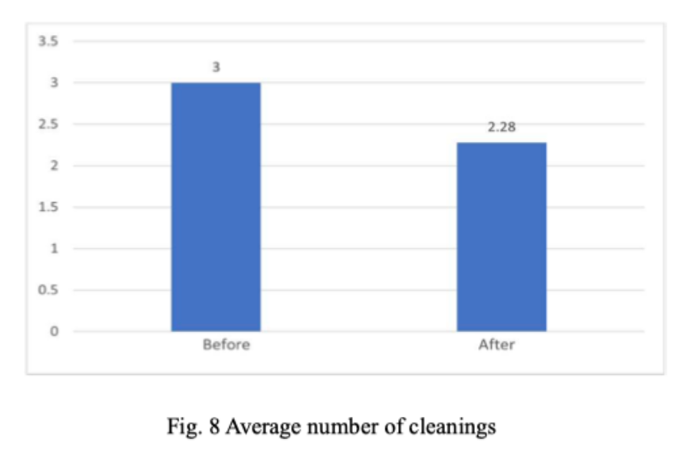
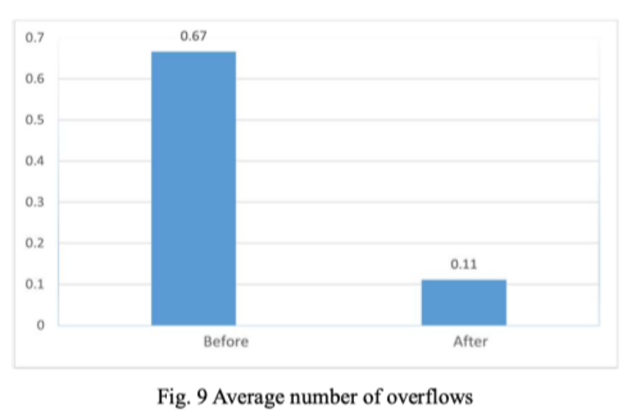
Notes:
After six days of experiments, the average cleaning times and the average overflow time of three different trash bins before and after the implementation of the garbage monitoring system are obtained in the following figures. The average number of garbage disposal tasks decreased form 3.00 to 2.28 times a day, which was reduced by 24.07%. While the average daily overflow time decreased from 0.67 to 0.11 times a day, which was reduced by 83.33%.

Slide 16



Notes:
And the final part is Conclusion and our future plan.

Slide 17

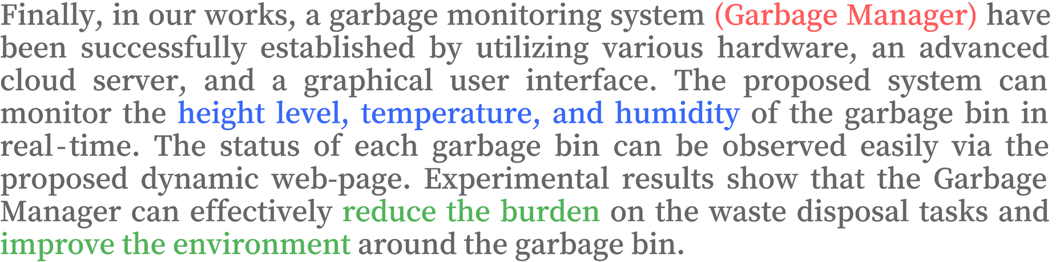
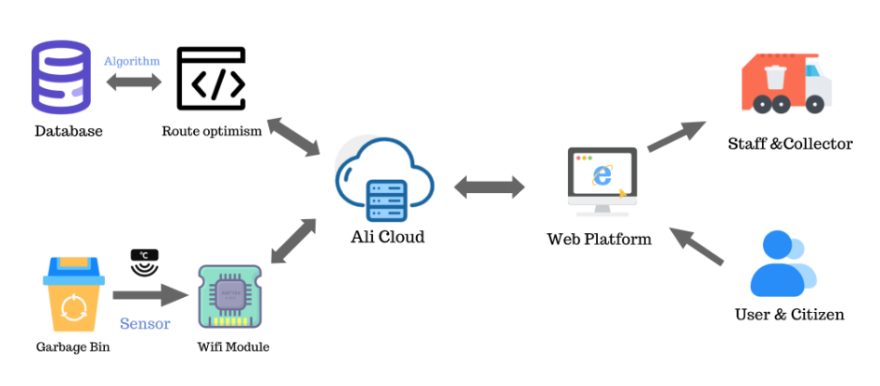
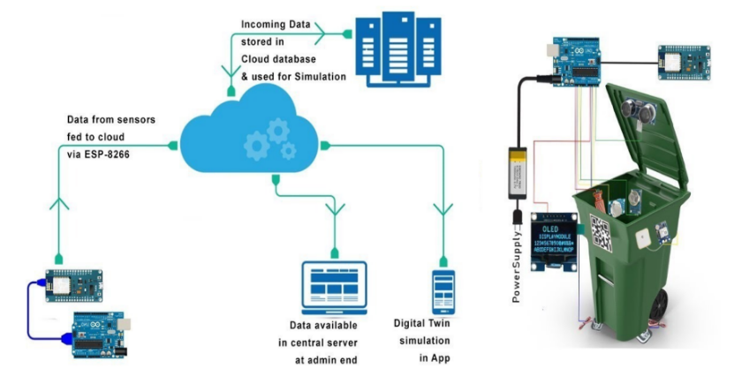
Notes:
So, in our works, a garbage monitoring system (called Garbage Manager) have been successfully established by utilizing various hardware, an advanced cloud server, and a graphical user interface. The proposed system can monitor the height level, temperature, and humidity of the garbage bin in real-time. The status of each garbage bin can be observed easily via the proposed dynamic web-page. Experimental results show that the Garbage Manager can effectively reduce the burden on the waste disposal tasks and improve the environment around the garbage bin.

Slide 18

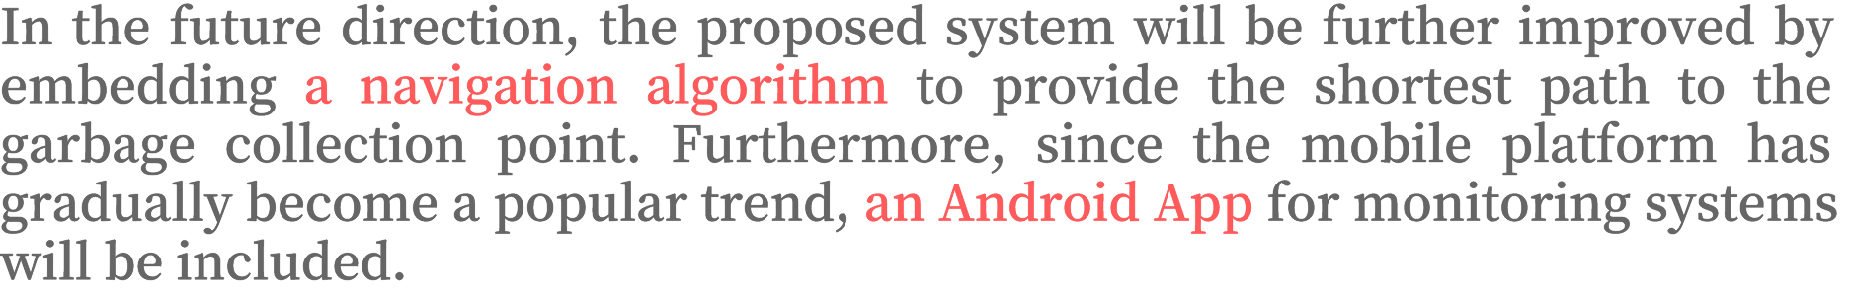

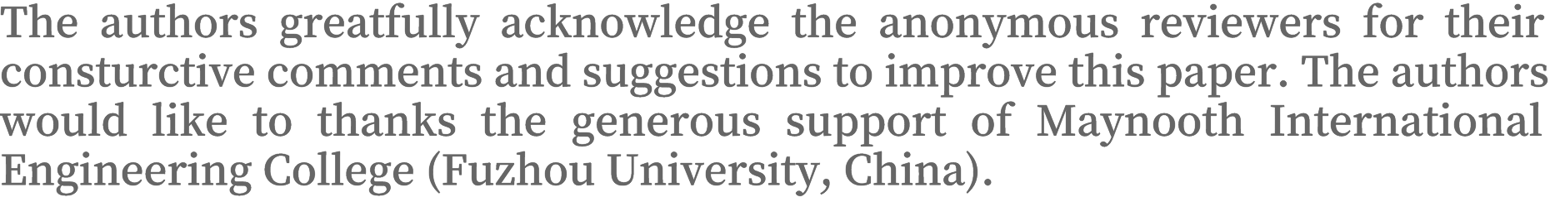

Notes:
As for the future direction, the proposed system will be further improved by embedding a navigation algorithm to provide the shortest path to the garbage collection point. Furthermore, since the mobile platform has gradually become a popular trend, an Android App for monitoring systems will be included.
In the end, here is my personal email and academic website. If you are interested in our works, please feel free to contact me at any time.

Slide 19





Notes:
So, that's all of my presentation today. Thank you for your listening!

